Slide 1

Idea
Requirement analysis
Techniques used in project
Detailed UI design
repository
Demo video
Final Project
Presentation
Team Name: Dynamic Duo
Team member: 최태진(TAEJIN CHOI) [Frontend/Backend],
김용민(YONGMIN KIM) [UI/UX, Docs]

Slide 2
Idea
Requirement analysis
Techniques used in project
Detailed UI design
repository
Demo video
Project idea

Slide 3
Idea
Requirement analysis
Techniques used in project
Detailed UI design
repository
Demo video
The difficulty of finding team members
The difficulty of coordinating schedules
Non-overlapping positions in the same filed
STUDY BUDDY

Slide 4
Requirement analysis
Idea
Techniques used in project
Detailed UI design
repository
Demo video
Requirement analysis

Slide 5





Requirement analysis
Idea
Techniques used in project
Detailed UI design
repository
Demo video
Welcome page
A general overview of the service
Modal Design
Login, sign-up, and other tasks are handled on a single screen without page transitions
Responsive Design
Responsive design ensures consistent UI/UX across browsers and mobile devices
Dark Mode
Users can select light or dark mode
User authentication
Provides login and sign-up via Firebase Authentication, with student verification through the Univcert API

Slide 6





Requirement analysis
Idea
Techniques used in project
Detailed UI design
repository
Demo video
DashBoard
View the clock, group status, and upcoming events
Group creation and management
Create groups and manage members
Schedule Matching
Analyzes members' schedules and automatically calculates a time when everyone is available
Calendar
Provides a clear overview of the schedule
User Profile
Set and manage personal information, interests, and department details

Slide 7
Idea
Requirement analysis
Techniques used in project
Detailed UI design
repository
Demo video
Techniques used in project

Slide 8







Idea
Requirement analysis
Techniques used in project
Detailed UI design
repository
Demo video
Client Side

Slide 9



Idea
Requirement analysis
Techniques used in project
Detailed UI design
repository
Demo video
Server Side

Slide 10





Idea
Requirement analysis
Techniques used in project
Detailed UI design
repository
Demo video
Collaboration Tools
CODE COLLABORATION
DESIGN
COLLABORATION
DOCS
COLLABORATION

Slide 11
Idea
Requirement analysis
Techniques used in project
Detailed UI design
repository
Demo video
Detailed UI design

Slide 12








Idea
Requirement analysis
Techniques used in project
Detailed UI design
repository
Demo video

Slide 13
Idea
Requirement analysis
Techniques used in project
Detailed UI design
repository
Demo video
logout user
logged-in user

Slide 14
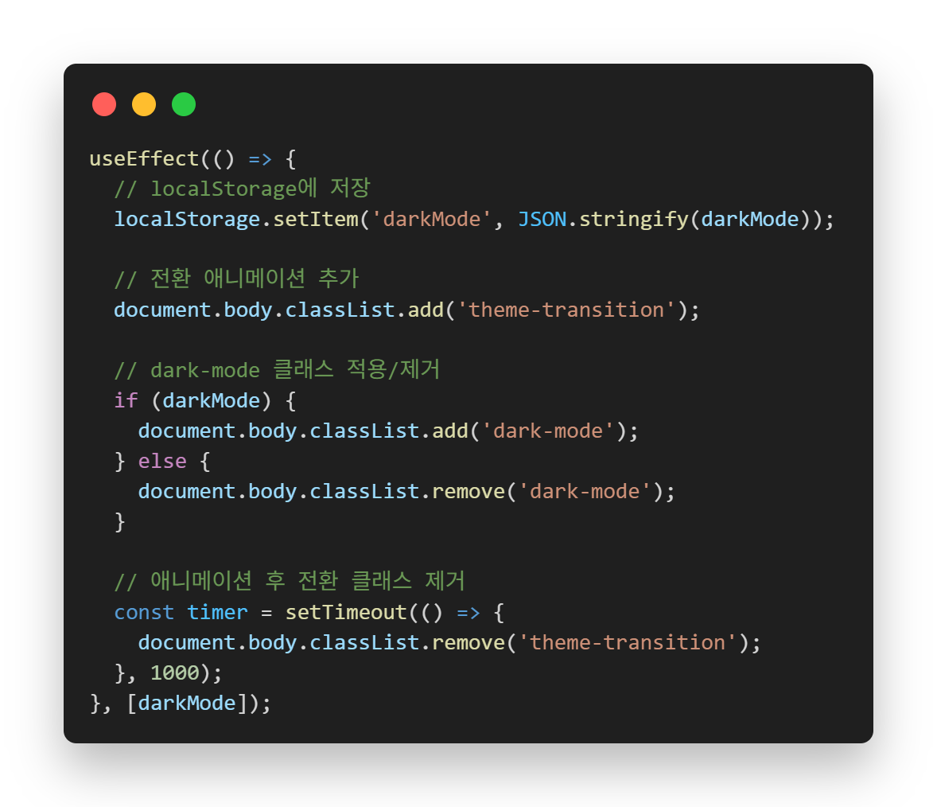
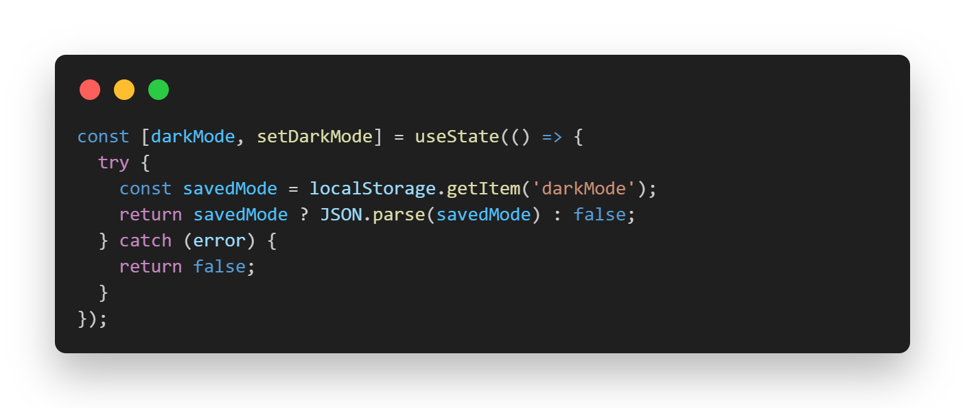
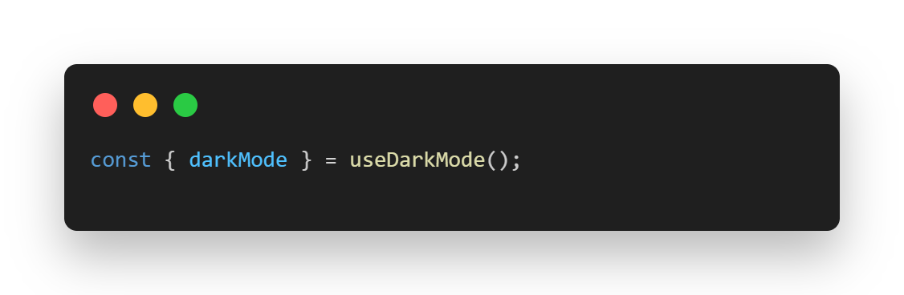
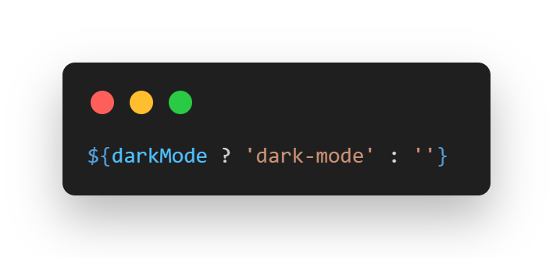
Idea
Requirement analysis
Techniques used in project
Detailed UI design
repository
Demo video

Slide 15
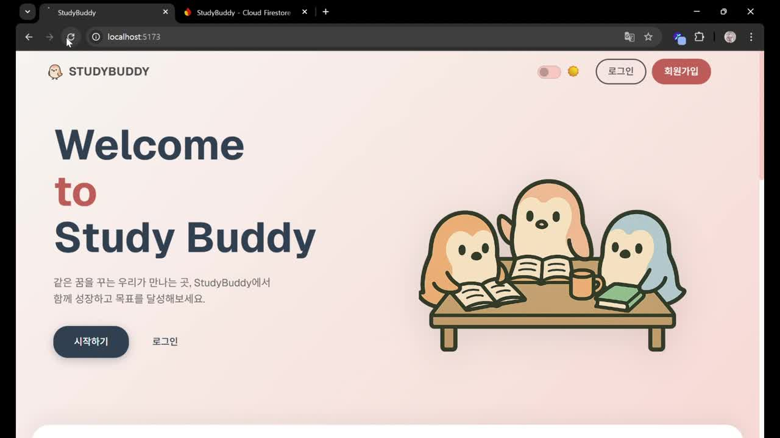
Idea
Requirement analysis
Techniques used in project
Detailed UI design
repository
Demo video

Slide 16
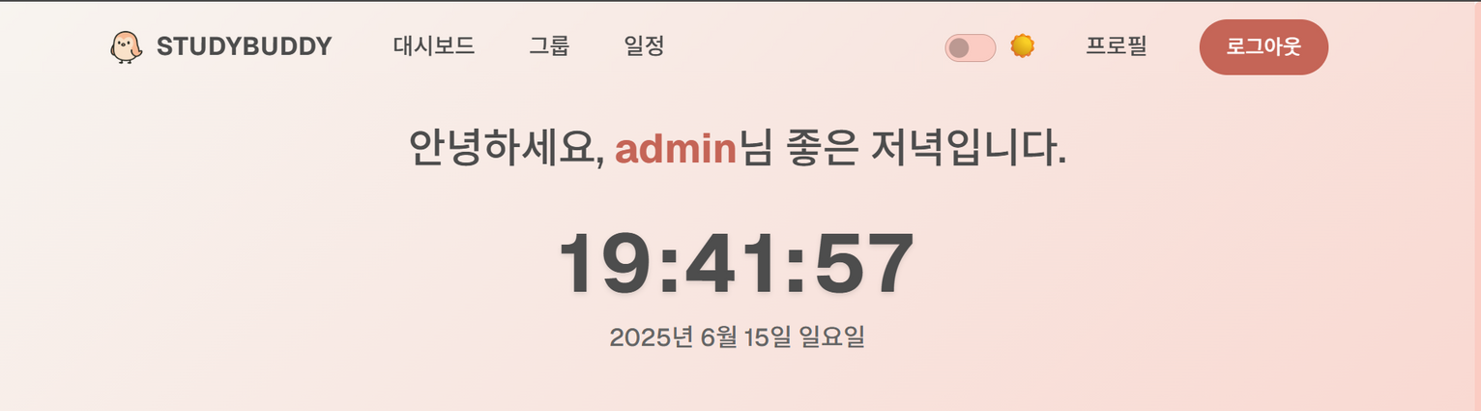
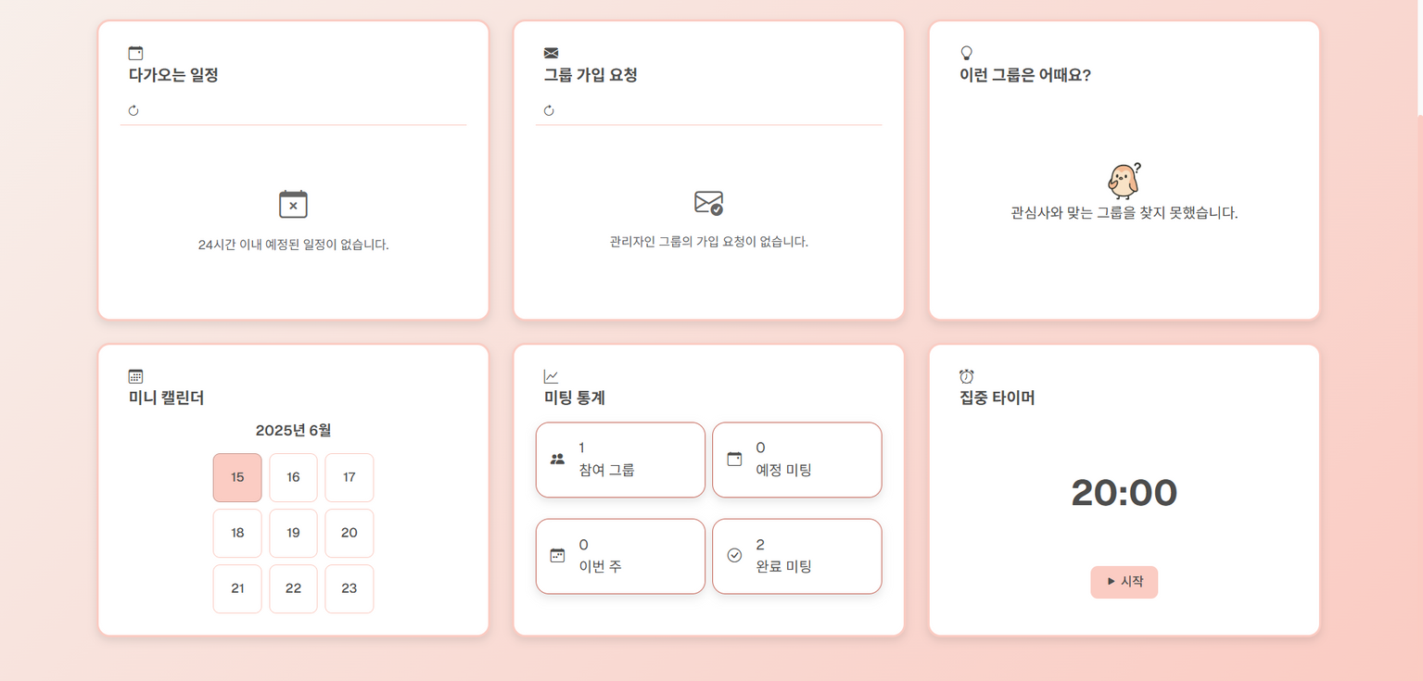
Idea
Requirement analysis
Techniques used in project
Detailed UI design
repository
Demo video

Slide 17
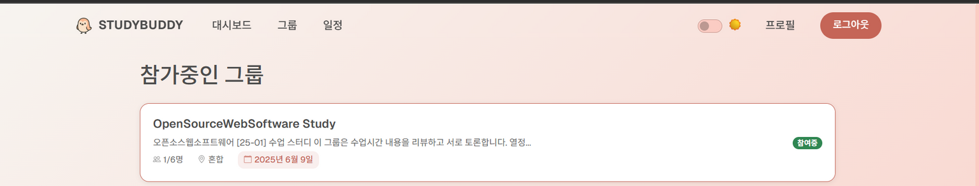
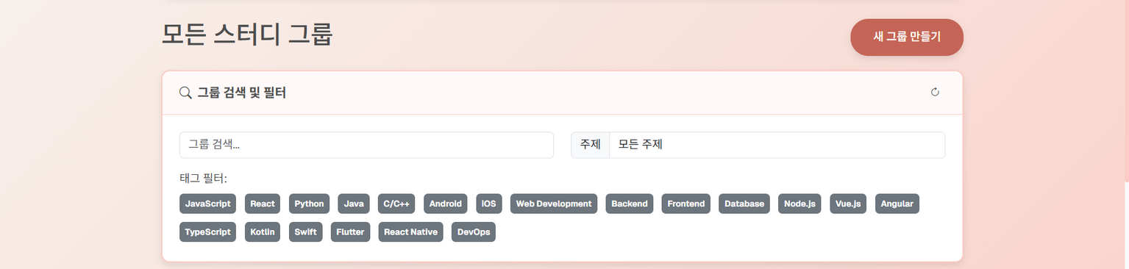
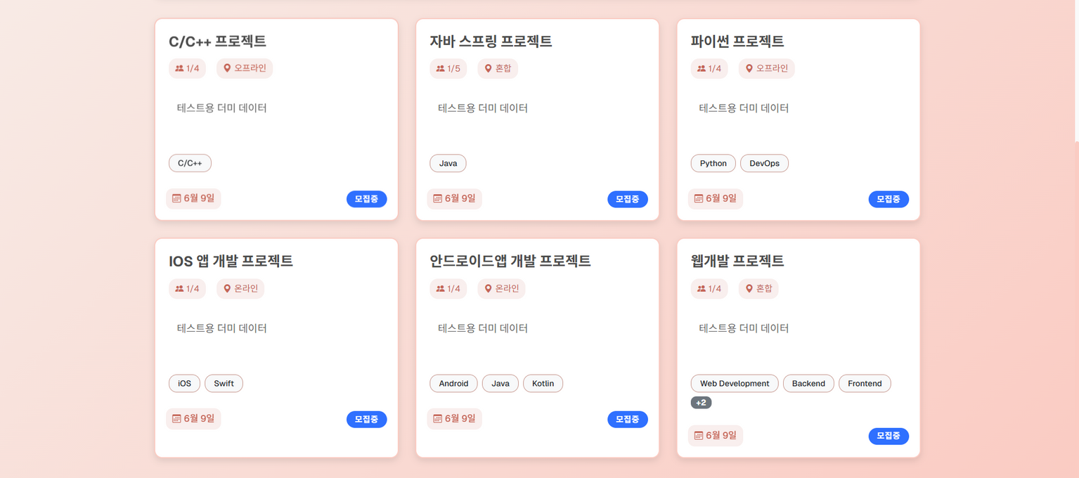
Idea
Requirement analysis
Techniques used in project
Detailed UI design
repository
Demo video

Slide 18
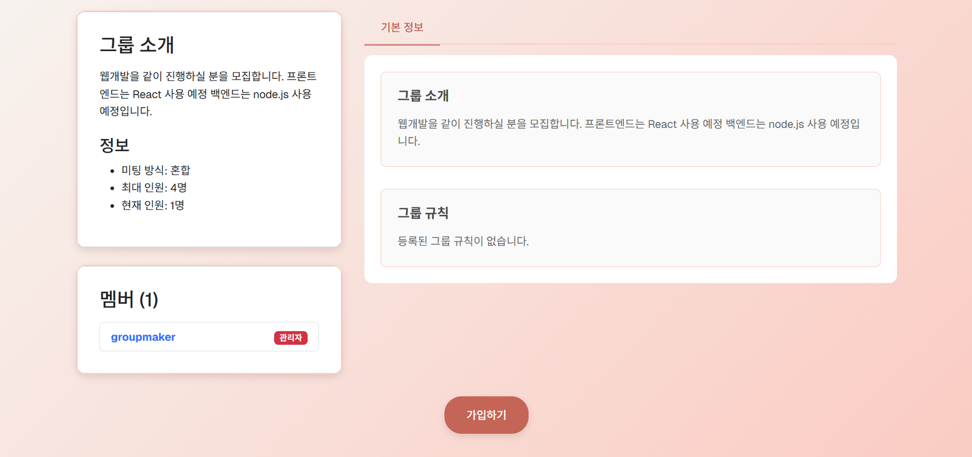
Idea
Requirement analysis
Techniques used in project
Detailed UI design
repository
Demo video

Slide 19
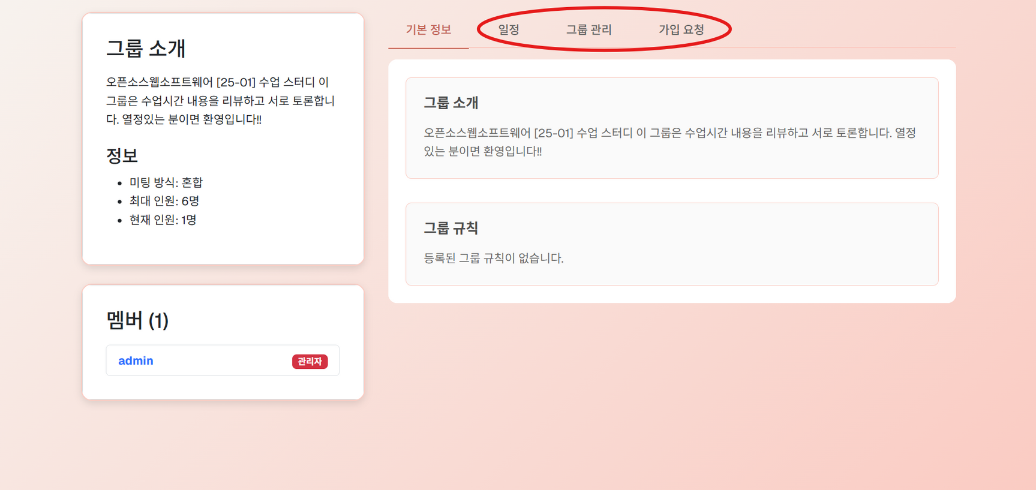
Idea
Requirement analysis
Techniques used in project
Detailed UI design
repository
Demo video

Slide 20
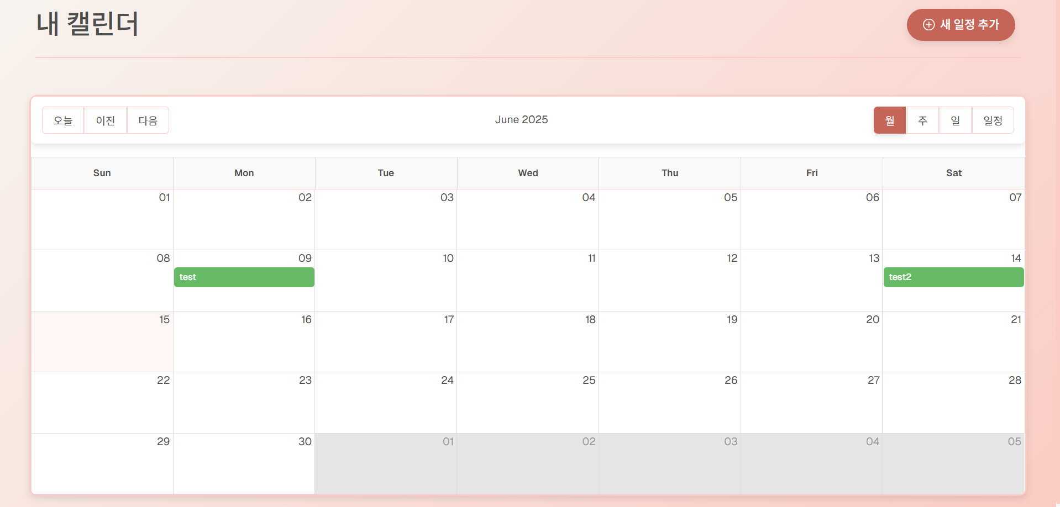
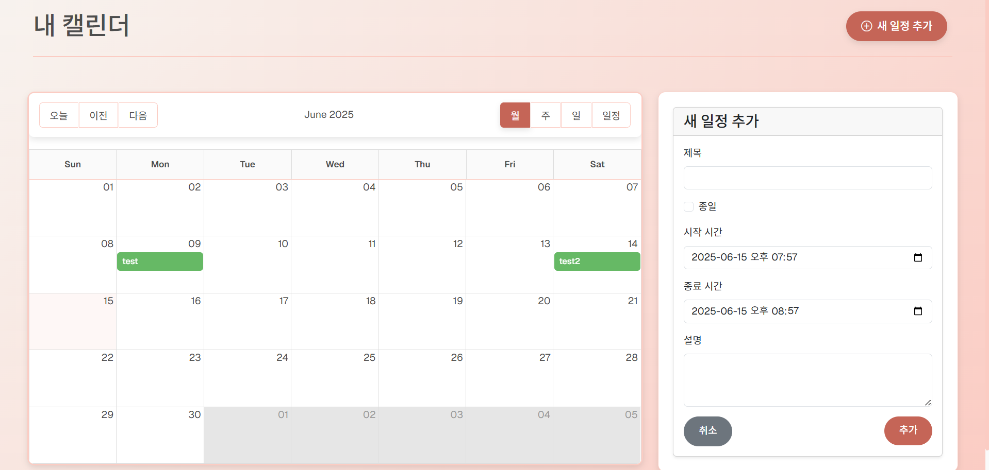
Idea
Requirement analysis
Techniques used in project
Detailed UI design
repository
Demo video

Slide 21

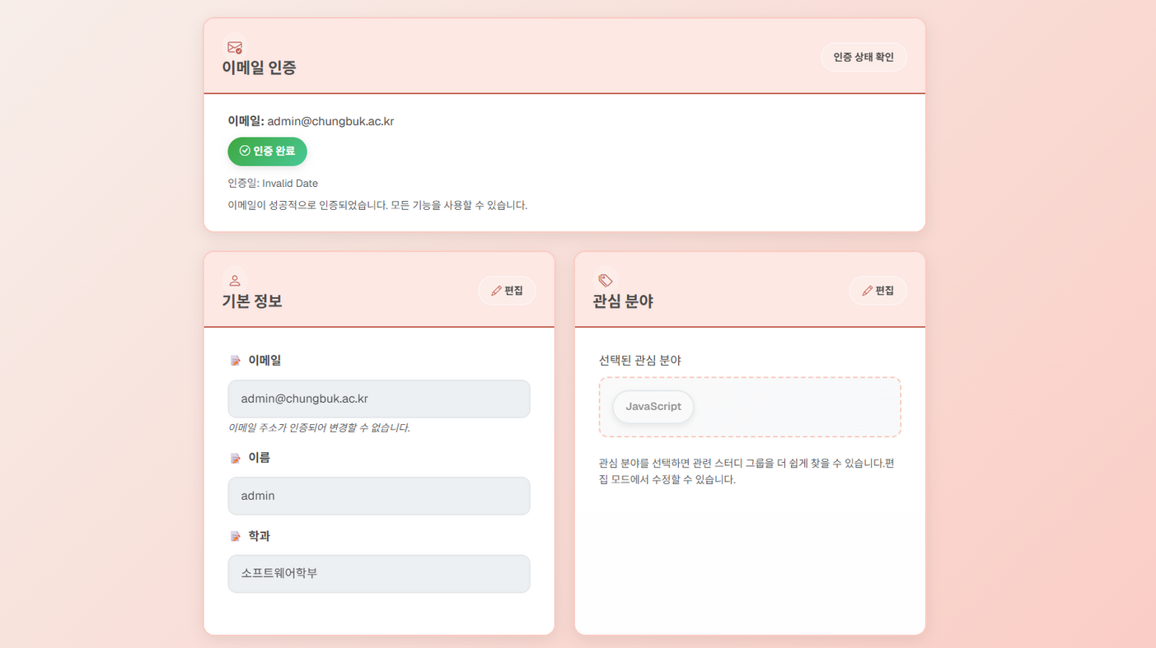
Idea
Requirement analysis
Techniques used in project
Detailed UI design
repository
Demo video

Slide 22
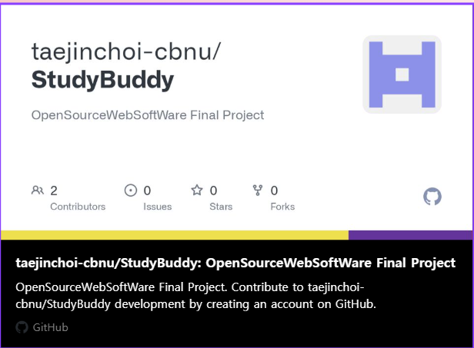
Idea
Requirement analysis
Techniques used in project
Detailed UI design
repository
Demo video

Slide 23
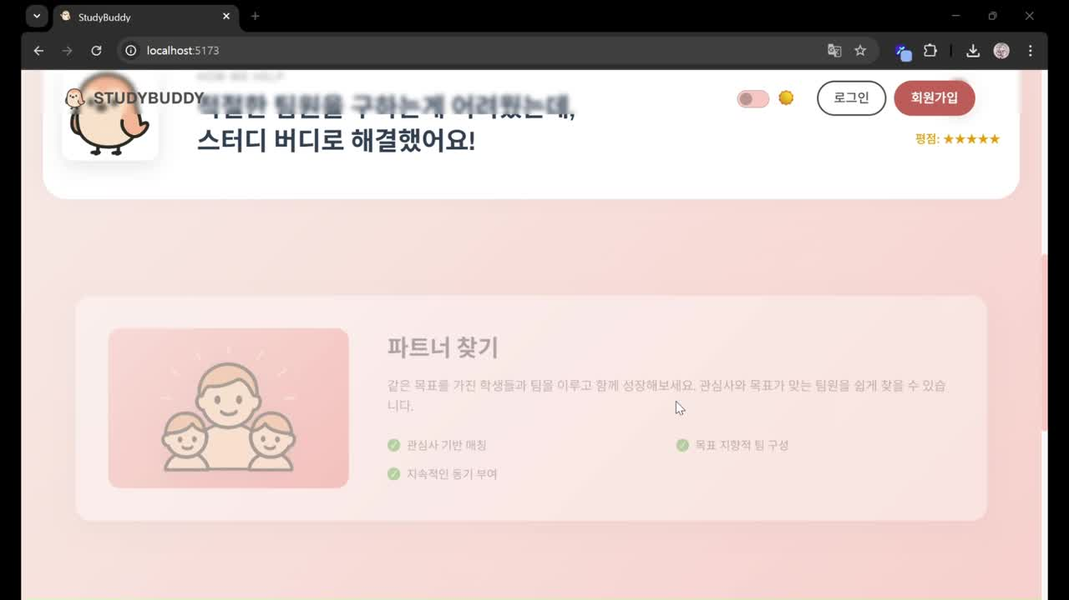
Idea
Requirement analysis
Techniques used in project
Detailed UI design
repository
Demo video

Slide 24
Thank You

